Slide 1
MANLY VALE FC
Information Evening ~ Season 2016
For Junior Coaches & Managers

Slide 2
WELCOME TO MANLY VALE!

Slide 3
Our Junior Development PROGRAMME
For all children aged 5-13 years.
Based on the current FFA National Football Curriculum.
The Discovery Phase (U6-U8).
The Skill Acquisition Phase (U9-U12).
Designed for teams training at least once a week.
To be used as a guide.

Slide 4
Our mission
“To increase the skill level of all players, across all age groups, by maximizing participation and instilling a lifelong love of football.”

Slide 5
Why do children play football?
To have fun.
To play with their mates and make new friends.
To learn new skills and teamwork.
To play a sport they can excel at.
To emulate their football heroes.
To try a different sport.

Slide 6
BUT What’s mosT important to children?
According to a recent survey, the 3 main reasons children play sport in Australia are:
To have fun.
To make friends.
To play and learn their chosen sport.

Slide 7
Did you notice that ‘winning’ was not in the top 3?
According to the same survey, children felt that ‘winning’ was most important to:
Their Coach
Their Parents
~ ‘Working With Kids Handbook 2015: Information for Coaches, Managers & Officials’, A Football NSW Publication, p. 14.

Slide 8
“Research has shown that intrinsic rewards, such as merely being involved in sport with their friends, mean more to children than the extrinsic rewards of receiving trophies or prizes.”
~ Murray Halls, ‘The Challenge of Engaging Young Children in Sport’, Australian Sports Commission, Active After School Communities Program, Volume 28, No. 4. http://www.ausport.gov.au/sportscoachmag/coaching_processes/the_challenge_of_engaging_young_children_in_sport

Slide 9
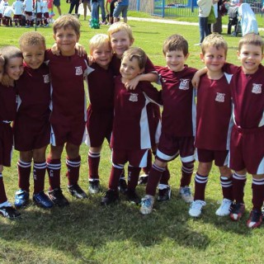
‘Trophies turn to rust; friendships gather no dust.’

Slide 10
‘Unless these needs are consistently being met, children are unlikely to continue playing football for very long.’

Slide 11
Our Football philosophy
‘If we have the ball, the opposition can’t score.’
Or . . . . . .

Slide 12
‘The better we are at keeping the ball, the less we have to defend.’

Slide 13
‘I’ve never forgotten the first thing they told me when I came to Barca as a little boy…. here you can never give the ball away.’
~ Xavi Hernandez, Barcelona midfielder

Slide 14
FOOTBALL NOT HOOF BALL!

Slide 15
But WHAT DOES THIS MEAN?
Football should be a joy to play and a pleasure to watch.
Football should be about scoring more goals than the other team.
All children are goal-scorers!
The thrill of scoring goals is bound to instil a lifelong love of the game.
Children should never be made to feel afraid of the ball.
In short, children should be taught to treasure the ball and not to kick it away!

Slide 16
The ball is their best friend!

Slide 17
MVFC junior playing style statement
“An possession-based style of attacking football, characterized by clever combination play and creative individual skill.”

Slide 18
OUR COACHING ETHOS
Genuine individual player development must be embraced as a long-term process that aims to establish deep-seated patterns of behaviour amongst all footballers from an early age.
Unlike senior coaches, who are concerned with preparing teams for their next match, the junior coach is instead responsible for preparing each player for a match in the distant future.

Slide 19
Seeing THE BIG PICTURE
Our Junior Development Programme thus encompasses an 8-year plan designed to prepare players for the youth and senior level when winning trophies does become more important.

Slide 20
Individual Player Development before Team Results
During the regular season, the progress of any match – whether positive or negative – should never be deemed more important than the long-term development of each and every individual player.
While, of course, winning is the purpose of any game, we must not allow this reality to occur at the expense of a child’s development.
The individual comes first, not the score!

Slide 21
That’s because at this age, the individual is still a child.

Slide 22
Weekend competition matches merely present each child with an opportunity to put into practice the skills they have been learning at training as well as the learning they have acquired since they first started kicking a ball.
The following tables demonstrate this:

Slide 23
LEARNING MATHEMATICS
Preparation | Classroom activities with the Teacher
Test | Sitting an Exam: Student demonstrates what they have learned. Teacher doesn’t intervene and help the student.

Slide 24
 | LEARNING FOOTBALL
Preparation | Training activities with a Coach
Test | Playing a Match: Player demonstrates what they’ve learned. Coach (or parent!) does not come onto the field to help the player (or play the game for them!).

Slide 25
As Coaches and dedicated supporters of our children we must view the training pitch and the playing field as part of the same classroom.

Slide 26
Question:
Do parents turn up to training and start coaching players?

Slide 27
So, why do we still allow parents to deliver instructions and coach – not just their own child – but other players in the team from the sidelines???

Slide 28
MV CLUB DIRECTIVE: NO SIDELINE COACHING FROM PARENTS
Let the Coach ‘coach’. One Coach = One Voice.
Parents can barrack and cheer to their heart’s content (positive!).
Children need to learn the game for themselves.
Children to need to make their own decisions without being told what to do all the time.
Making mistakes is how they grow and learn the game.

Slide 29
Learning HOW TO PLAY the game is more important than winning a game
Remember, the Junior Coach is concerned with how each player is developing towards becoming an accomplished footballer when it really counts – at the youth and senior level.
This means that on match-day, the overall focus should still be on the individual, not merely the team’s performance.
Whatever happens, this player-centred approach must never be abandoned on match-day simply because of the score!

Slide 30
MV CLUB DIRECTIVE: MANDATORY ROTATION OF ALL PLAYERS In ALL POSITIONS (UNTIL U13)
Increases game awareness.
Enhances technical development by maximizing participation and contact with the ball. ‘More touches’ = greater improvement.
Provides all players with an opportunity to score a goal – irrespective of whether their team is ‘winning’ or ‘losing’.
All players need to learn how to attack and how to defend.
Reduces boredom and drop-out.
Increases confidence and self-esteem.

Slide 31
‘By the end of the season, every player must have played at least half a game in every position.’

Slide 32
In the past, the only reason why Coaches played kids in the same positions every week WAS TO WIN.
Stronger players in the key positions. TOO EASY!
Weaker players where are they unlikely to see much of the ball and thus make less mistakes. TOO EASY!

Slide 33
“Young kids should be taught how to play in every area of the pitch, not taught to play a specific role. They don’t need to be taught a role because it is innate. Every player has a natural disposition towards one role or another, but first they have to learn how to play everywhere.”
~ Marcello Lippi, Former Italian National Team Coach & 2006 World Cup Winner.

Slide 34
WHAT IS TALENT?
Talent means being able to repeat a skill effectively and consistently over an extended period of time.
Is talent innate? (‘in the genes’)
Think of the world’s greatest footballers (Pele, Messi).
How many times have you heard someone say . . . .
“They were born with something I wasn’t born with. They are gifted.”

Slide 35
Today’s concept of talent is still part of an old cultural legacy.

Slide 36
“Don’t ask, young artist, what is genius? Either you have it or you don’t.”
~ Jean-Jacques Rousseau, French Philosopher, 1792 (!)

Slide 37
If we continue to believe that attaining excellence hinges on natural talent, our children are likely to give up if they show insufficient early promise.
Perfectly rational given the premise! But . . . .

Slide 38
“People make a great mistake if they think that my art has ever come easily to me. Nobody has devoted so much time and thought to composition as I.”
~ Mozart

Slide 39
“I make many changes and reject and try again, until I am satisfied. Only then do I begin the working-out in breadth, length, height and depth in my head.”
~ Beethoven

Slide 40
“Contrary to what we’ve been taught, genes do not determine physical and character traits on their own. Rather, they interact with the environment in a dynamic, ongoing process that produces and continually refines an individual.”
~ ‘The Genius in All of Us: Why Everything You’ve Been Told About Genetics and IQ is Wrong’, Dr David Shenk, Random House, 2010, p. 13.

Slide 41
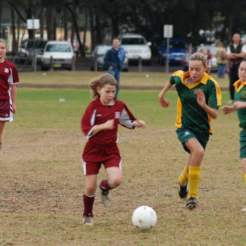
Talent is the result of something, not the cause.
Effort and practice.
Environment.
Unusual circumstances.

Slide 42
DON’T FORGET The rule of 10,000 hrs!
It is generally accepted that it takes around ten years of purposeful practicing and playing to progress from first experiencing football to being able to function successfully as a player in a competitive 11v11 game.
It is only after this time that we begin to see more talented players emerging . . . . .

Slide 43
Of course, nobody can claim that a person who has performed 10,000 hours of practice is guaranteed greatness.
The science has merely shown this to be one of the necessary conditions of extraordinary achievement.
In essence, there is a vast difference between practice and deliberate practice.
. . . . . . And deliberate practice is tough!

Slide 44
PROMOTING A ‘GROWTH MINDSET’
At Manly Vale we believe the key difference in skill level between all our junior players is due to the amount of time they have each spent on the ball from a young age.
That’s why we believe every junior has the potential to become an accomplished footballer in the future.

Slide 45
As a grassroots club it is thus our responsibility to reduce the gap in ability between all players by ensuring everyone is given the same training and learning opportunities.
Hence, our new Junior Development Programme.

Slide 46
‘Practice makes Permanent.’
~ Bobby Robson

Slide 47
HOW A GROWTH MINDSET WORKS
FIXED MINDSET | GROWTH MINDSET
Talent = innate Failure = de-motivation No Perseverance – ‘I don’t have the talent so I’ll never be able to do this.’ | Talent = trainable and coachable. Failure = extra motivation Strong Perseverance – ‘I can learn and improve through effort and practice.’
OUTCOME | OUTCOME
Achievement of mediocrity. | Achievement of excellence.

Slide 48
WHAT COACHES AND SUPPORTERS CAN DO TO INSTIL A GROWTH MINDSET
Praise effort, not talent.
Teach players to see every mistake as a learning opportunity.
‘If you’re not making mistakes, you’re not improving.’
Making mistakes is also a biological requirement for learning skill.
Teach players to play without fear of failure.
Kids are much harder to coach if they play with fear.
Ensure challenges are not too difficult and not too easy, but just out of reach.

Slide 49
“True motivation comes from finding the ideal point of being challenged. When kids are overly challenged, they may give up because the expectations are too high. If they’re not challenged enough, they may become bored.”
~ ‘Mindset: The New Psychology of Success’, Dr Carol Dweck.

Slide 50
As Coaches we must strive to find the right balance for our players whenever possible……

Slide 51
But first . . . .
WE HAVE TO KNOW OUR PLAYERS.

Slide 52
THE DISCOVERY PHASE (5-8yrs)
Key Characteristics of this age group:
They are still clumsy and lack fine motor skills.
They have a short attention and are quickly and easily distracted.
They are self-centred and unable to work together – SO DO NOT ASK THEM TO PLAY AS A TEAM AS IT IS IMPOSSIBLE FOR THEM!
The play for fun with short bursts of energy and enthusiasm.
They are unable to absorb a lot of information.

Slide 53
FORWARD Solutions?
Plan your sessions in advance and arrive early to set up.
Give clear, short instructions and ALWAYS DEMONSTRATE.
Be enthusiastic and give lots of praise.
ENCOURGE especially after a mistake is made.
Be patient and SMILE.
Have fun (both the kids and you!)
Keep everyone active to avoid having kids standing around.

Slide 54
THE SKILL ACQUISITION PHASE (9-12YRS)
Key characteristics of this age group:
They are highly motivated and enthusiastic.
They are competitive and like to be challenged.
They are well balanced and coordinated (prior to growth spurt).
They are very adaptive to learning motor (technical) skills.
They are still self-centred but are beginning to learn how to play together.
They are sensitive to criticism and failure.
They are physically and mentally ready for a more structured approach to training.

Slide 55
THIS is the GOLDEN AGE OF MOTOR LEARNING
At no other development phase will motor learning happen faster than here.
TECHNIQUE MUST BE DEVELOPED NOW (if children miss out here it will hamper them for the rest of their playing career).

Slide 56
OUR COACHING Method
Holistic.
Games-based.
= More decision-making.
= More problem-solving.

Slide 57
Traditionally, technique has been taught before decision-making. In other words, in isolation.
But why spend so much time on static drills if we only get to train once a week?

Slide 58
Learning technique in isolation from decision-making is ultimately unrealistic because every football action is preceded by a decision.

Slide 59
A holistic approach means improving a player’s level of football skill in game-realistic situations.

Slide 60
WHAT IS FOOTBALL SKILL?
FFA definition:
“The consistent ability to quickly select and perfectly execute the correct football action for the situation.”
Or . . . . .
‘Skill is where intent equals outcome.’

Slide 61
WHAT IS A FOOTBALL ACTION?
At its most basic level, a football action relates to a specific individual action performed by a player at any one time.
The current (FFA) National Curriculum has further grouped these actions into four generic core skills that may be applied to teams when in possession of the ball.

Slide 62
FOOTBALL ACTIONS
First Touch
Striking the Ball
Running with the Ball
1v1

Slide 63
These four core skills cover 95% of the actions of any outfield player when in possession of the ball during a game of football.
The other 5% consists of actions such as heading and throw-ins.

Slide 64
FIRST TOUCH
Receiving the ball with different parts of the body (ie: feet, chest, thigh, head) in order to execute what you decided to do prior to the ball arriving.

Slide 65
STRIKING THE BALL
Passing, shooting, crossing and heading in order to:
Keep possession
Change the point of the attack (switching play).
Deliver ‘killer passes’.
Play ‘wall passes’.
Score goals!

Slide 66
RUNNING WITH THE BALL
Dribbling or travelling forward with the ball in order to:
Attack free space.
Commit or lure a defender out of position.
Allow team-mates to make runs or get into position.
Create a numerical advantage for the team.

Slide 67
1 v 1
Faking or changing direction with the ball in order to lose a defender and create space to:
Run with the ball.
Pass, cross or shoot.
Create a numerical advantage for the team.

Slide 68
“In the Discovery & Skill Acquisition Phases, we are developing skills in individuals, not fixing team problems (if we are successful in this phase, however, we will prevent future problems).”
~ ‘The Football Coaching Process: An Official FFA Publication’, 2013, Kelly Cross, p. 193.

Slide 69
CONDUCTING A TRAINING SESSION
The Discovery Phase (U6-U8):
Session Objective.
Core Skill focused.
3-part format: Beginning, Middle & End.
Duration: 45-50 minutes.

Slide 70
CONDUCTING A TRAINING SESSION CONT’D)
The Skill Acquisition Phase (U9-U12):
One session devoted to each one of the core skills.
3 x Sessions designed per core skill.
12 session cycle.
3-part format: Skill Intro, Skill Training, Skill Game.
Promote a ‘theme of learning.’
Duration: 60-75 minutes.

Slide 71
OUR CORE VALUES
‘At Manly Vale, who you are as person will always be more important to us than how good you are as a footballer.’

Slide 72
OUR CORE VALUES (CONT’D)
At Manly Vale, we see the game of football as a medium through which all our aspiring young players are able to learn a number of important human values, something that can only make them better people in the years to come.
Through football, all our juniors shall be taught the value of:

Slide 73
OUR CORE VALUES (CONT’D)
Effort
Fairness
Respect
Humility
‘Personal Growth through a love of football.’

Slide 74
“I’m more worried about being a good person than being the best football player in the world. When this is all over, what are you left with? When I retire, I hope I am remembered for being a decent guy.”
~ Lionel Messi, 2015

Slide 75
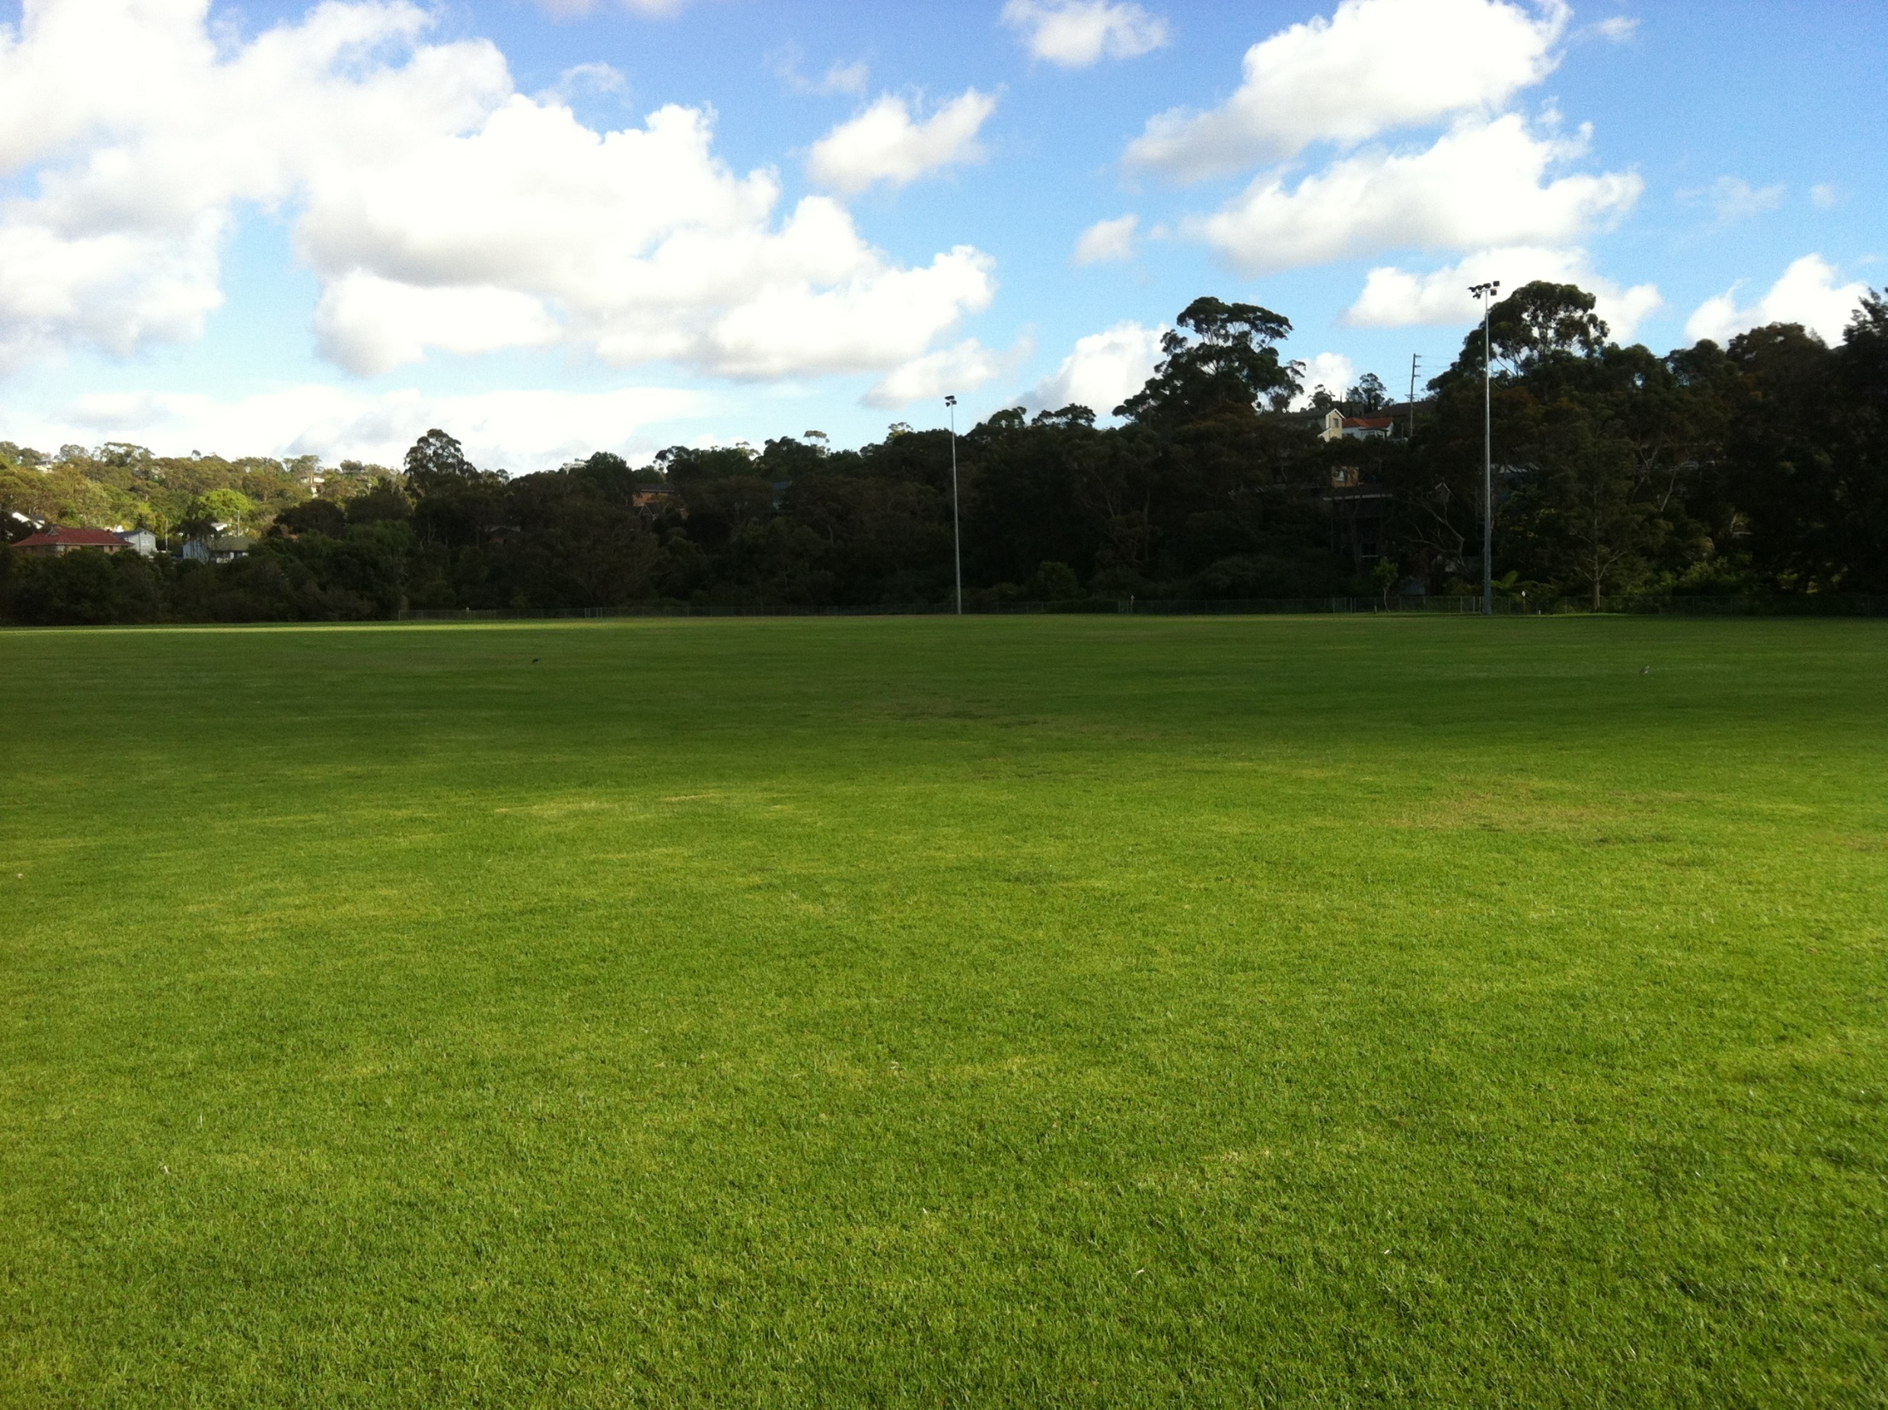
Questions???

Slide 76
THANK YOU AND GOOD LUCK!
WE ARE FOOTBALL, WE ARE MANLY VALE.

